Slide 1
A Collaboration by GSAN and Green Labs Initiative

Slide 2
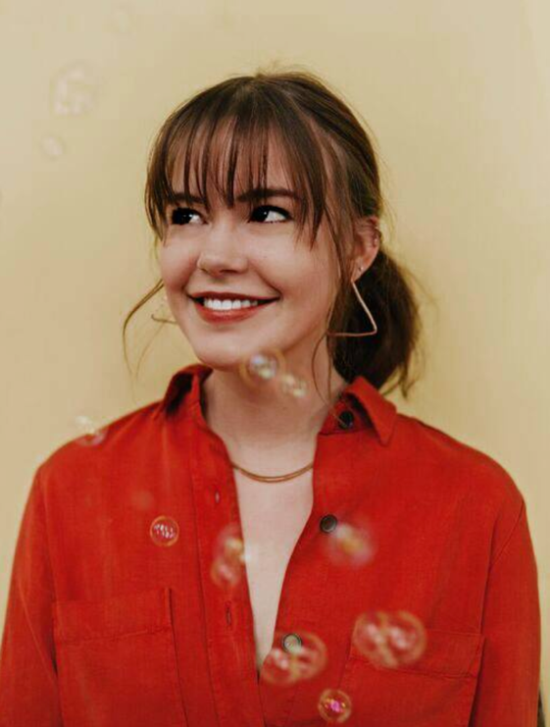
Who we are
Claire Honda
Alex Chapleau

Slide 3
What is Sustainability?
The ability to exist constantly
The capacity for the biosphere and human civilization to co-exist

Slide 4
Sink
i.e. waste outputs back into the environment
Source
i.e. resource inputs from nature

Slide 5
Sink
Source

Slide 6
“Being sustainable makes sense” - Anonymous

Slide 7
Ecological Footprint

Slide 8
#movethedate
https://www.overshootday.org/

Slide 11
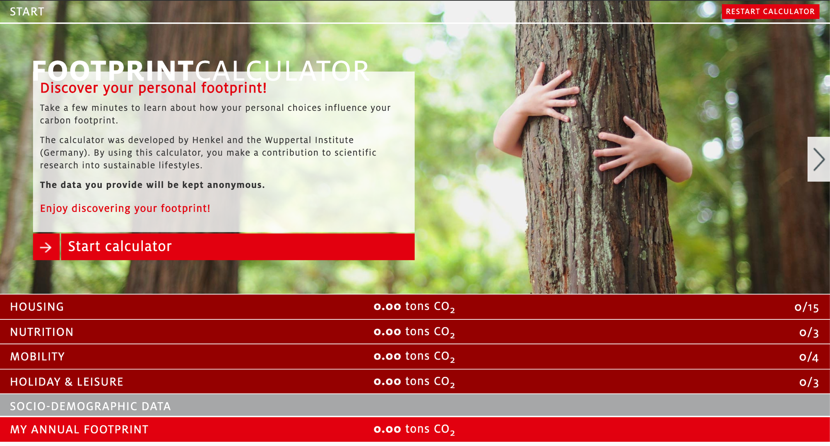
https://footprintcalculator.henkel.com/en

Slide 12
How can I implement sustainability into my life?

Slide 13
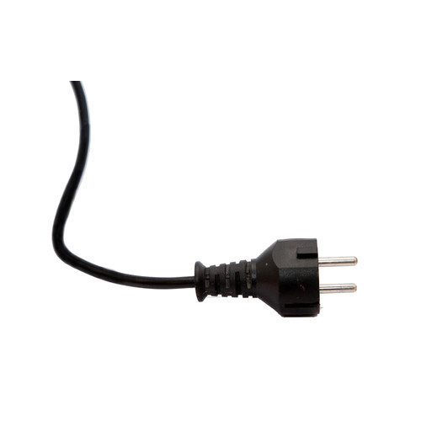
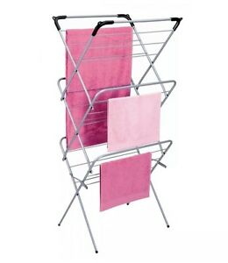
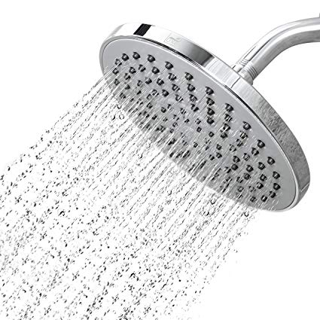
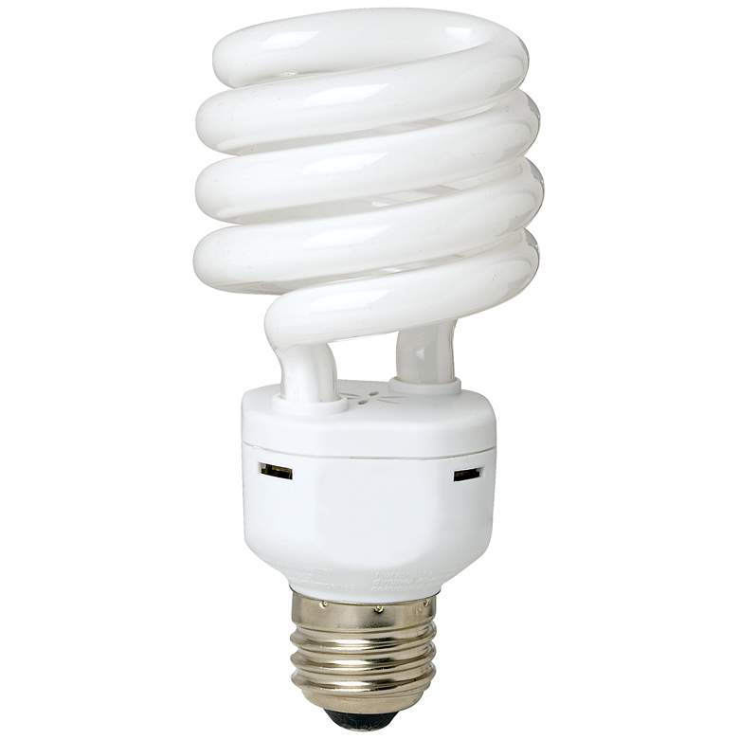
Practices to implement

Slide 14
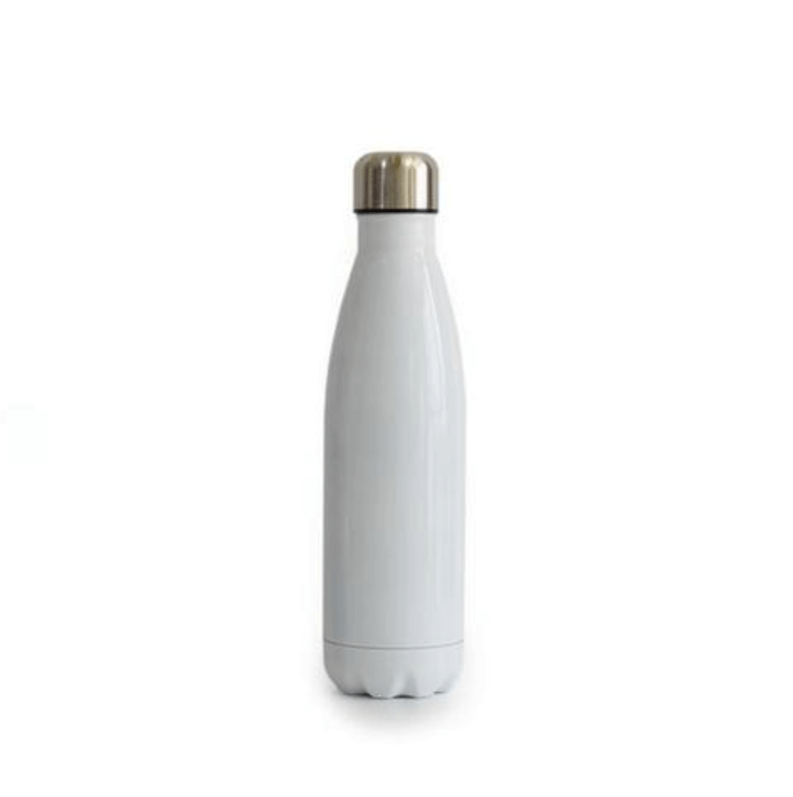
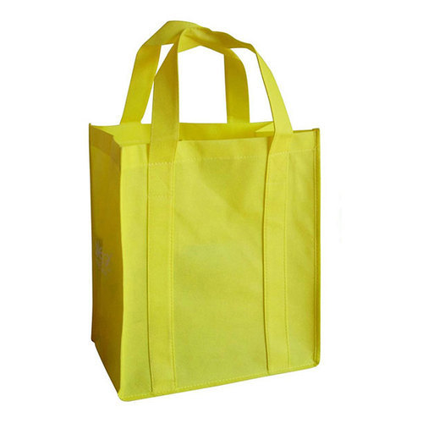
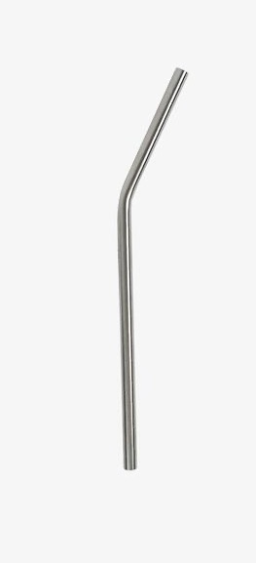
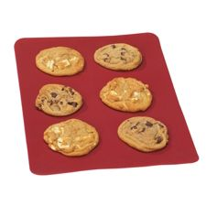
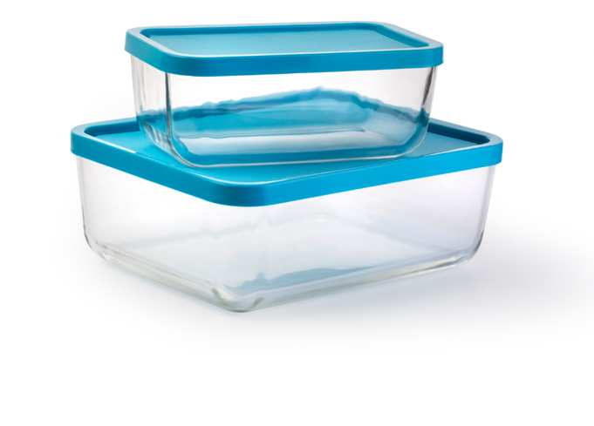
Practices to implement
Notes:
- Use a reusable water bottle and coffee mug
- Bring a plate or tupperware with you when you’re going to a seminar with food or a restaurant where you might have leftovers
- Leave a cloth bag and an empty container in your bag so they’re ready whenever you have time to go shopping
- When you buy fruits and veggies, don’t bother putting them in plastic bags
- Avoid single-use versions of items like straws, muffin wrappers, aluminium foil, etc.; use alternatives like metal straws and silicone baking mats

Slide 15
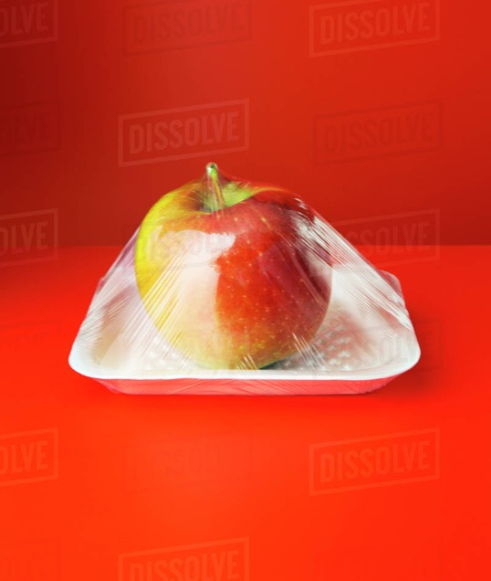
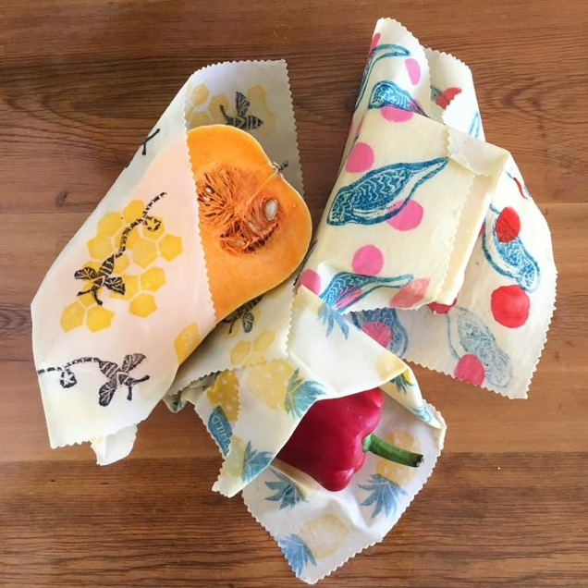
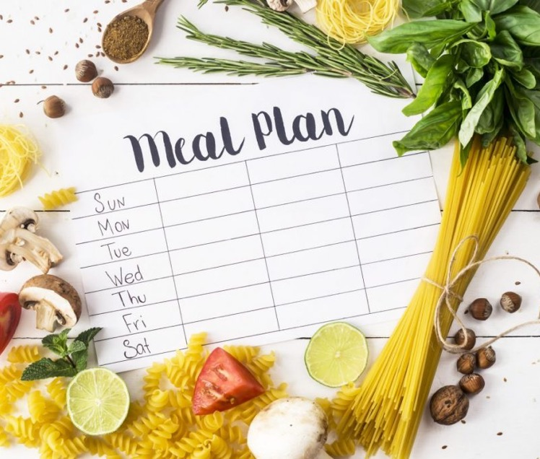
Practices to implement

Slide 16
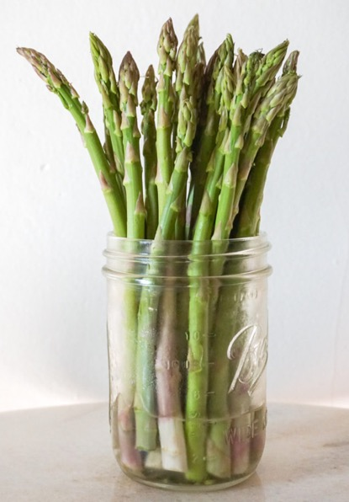
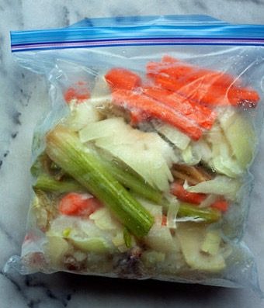
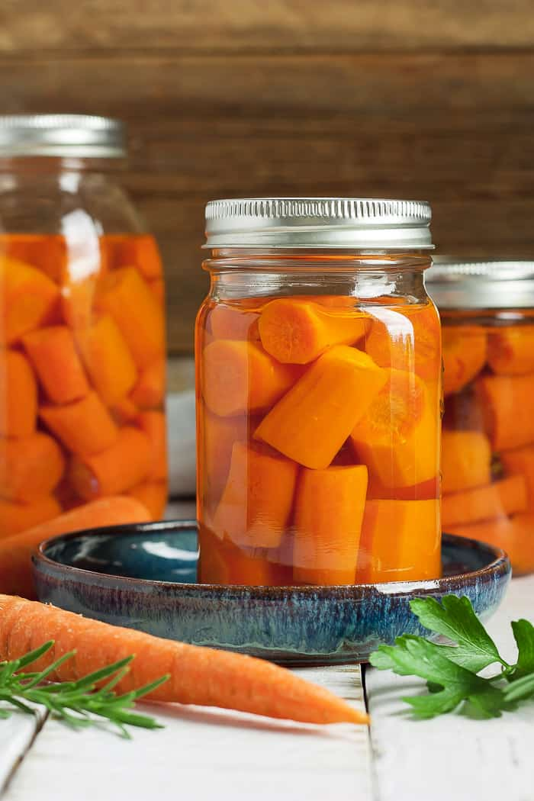
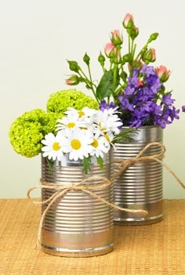
Practices to implement
(https://sweetsimplevegan.com/2019/04/tips-for-storing-produce/)

Slide 17
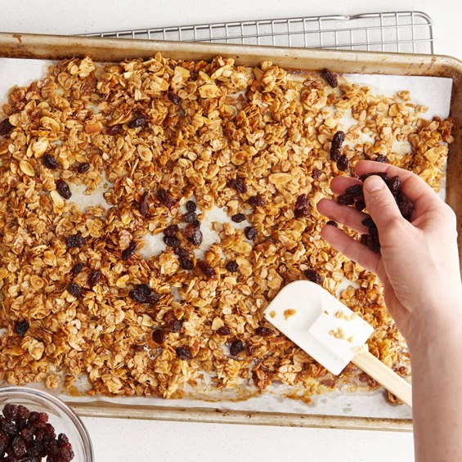
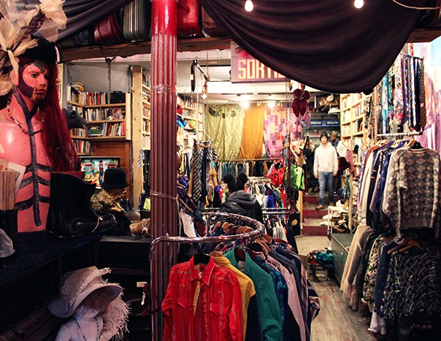
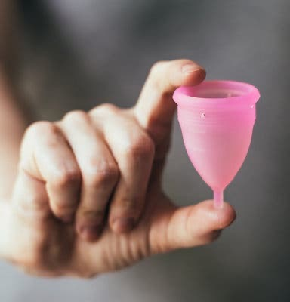
Practices to implement

Slide 18
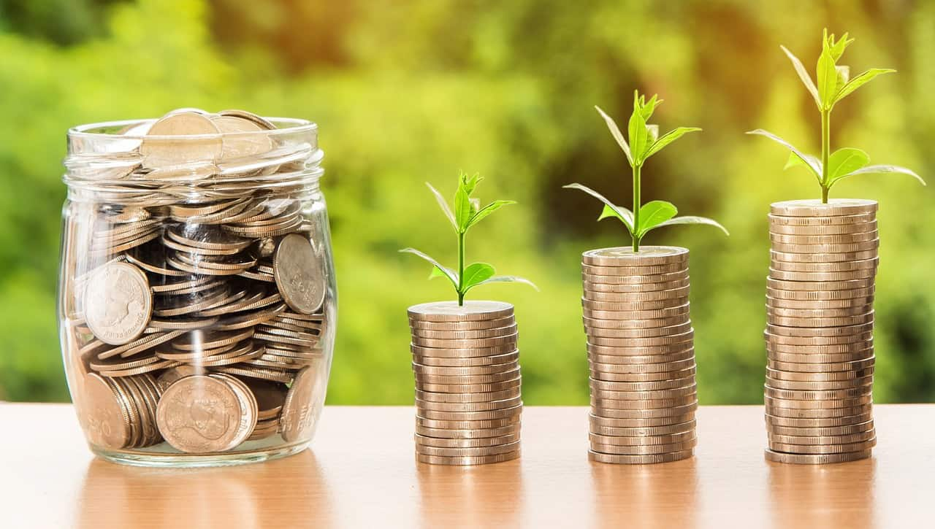
Bonus: Save $$$!
For more ideas: https://www.curbed.com/a/how-to-live-sustainably?fbclid=IwAR10kSWV9pQkSs0p04KVK3nt6RYWWINameVopdJ4siX9epMQe6EKaYNXvsw

Slide 19
What is zero-waste?

Slide 20
What is zero- waste?

Slide 21
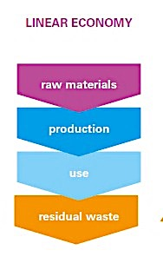
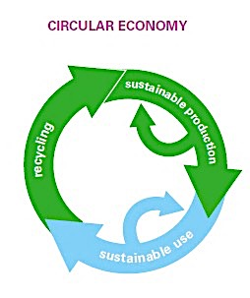

Slide 22
Transitioning to a minimal-waste lifestyle
Bea Johnson
Lauren Singer

Slide 23
https://zerowastehome.com/
http://trashisfortossers.com/

Slide 24
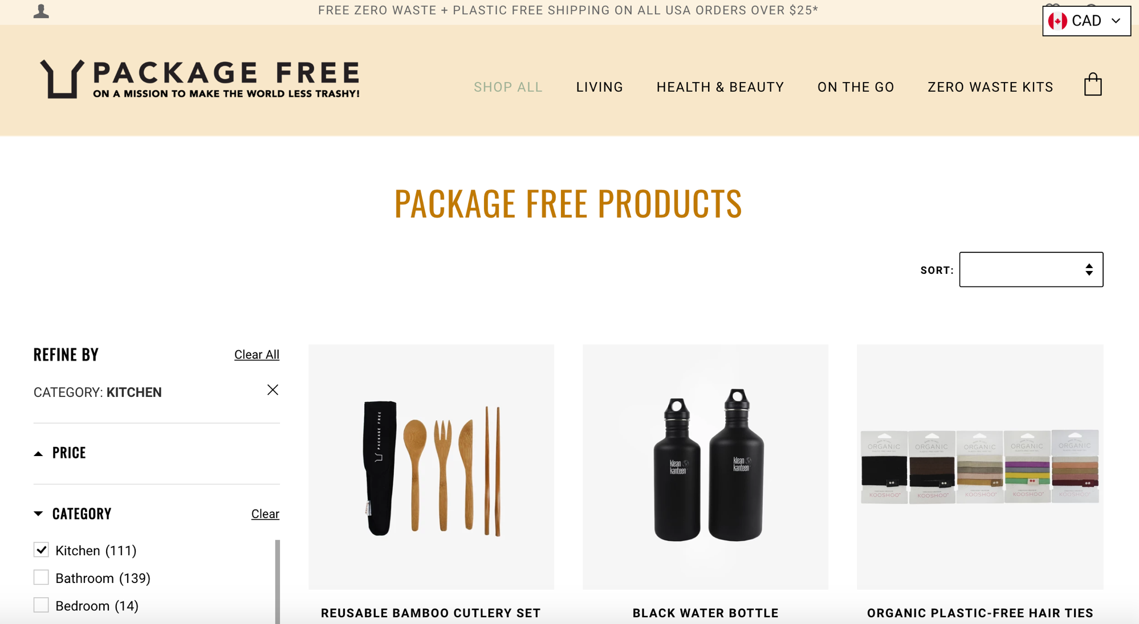
https://packagefreeshop.com/

Slide 25
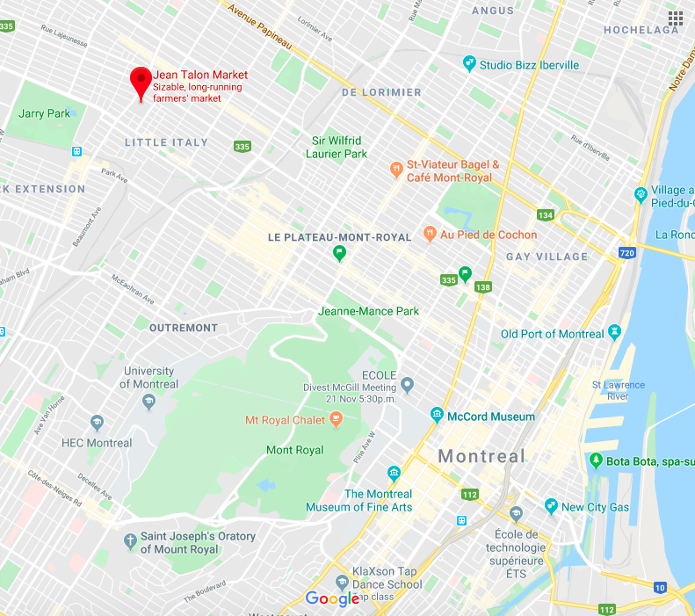
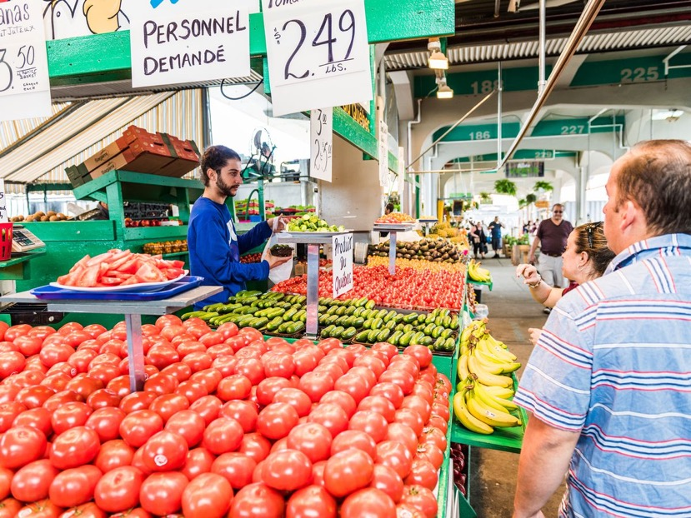
Zero-waste/bulk stores
Jean Talon market

Slide 26
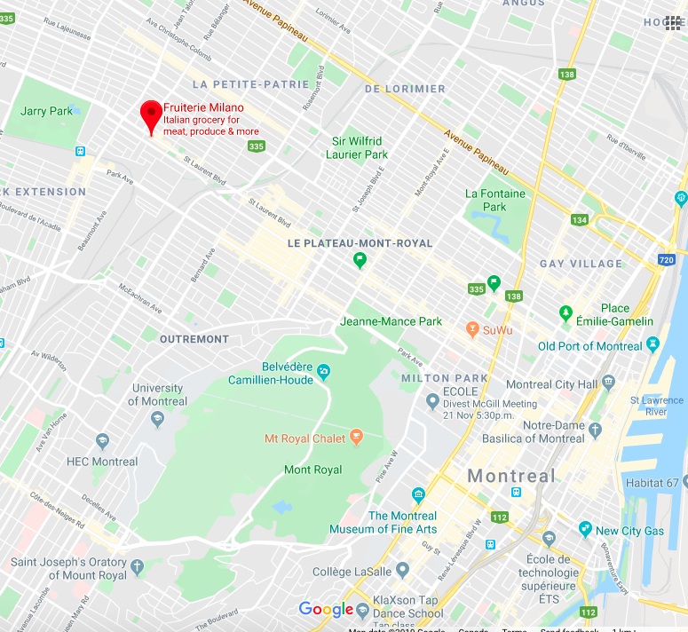
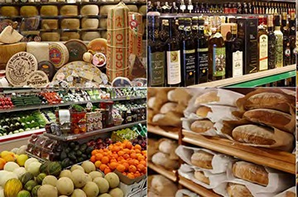
Zero-waste/bulk stores
Milano

Slide 27
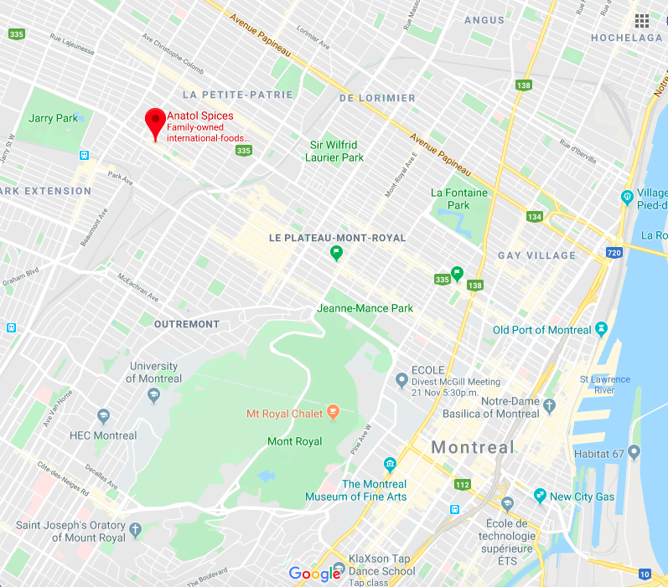
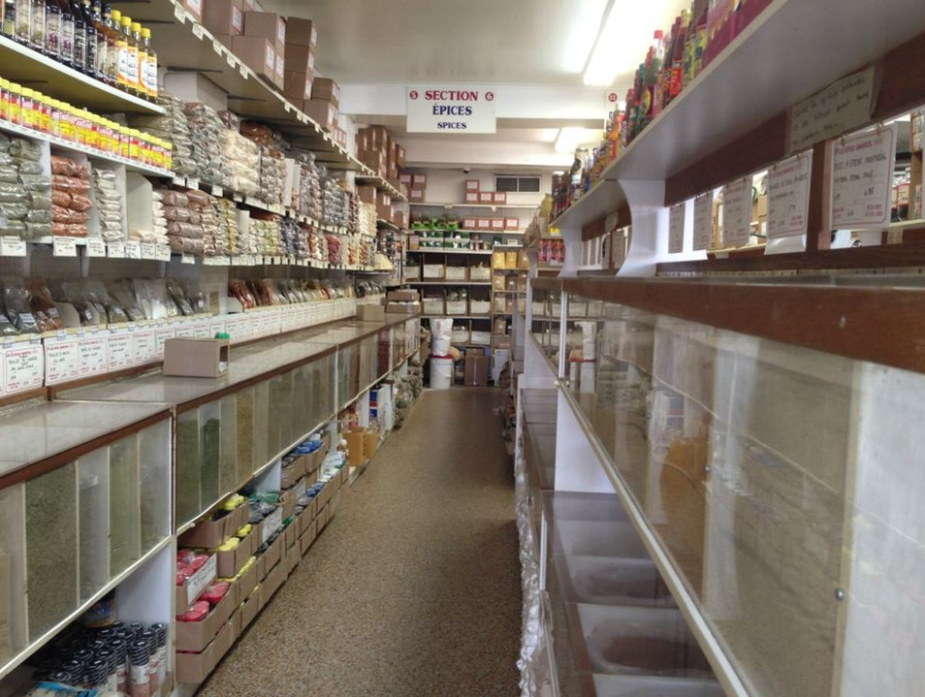
Zero-waste/bulk stores
Anatol Spices

Slide 28
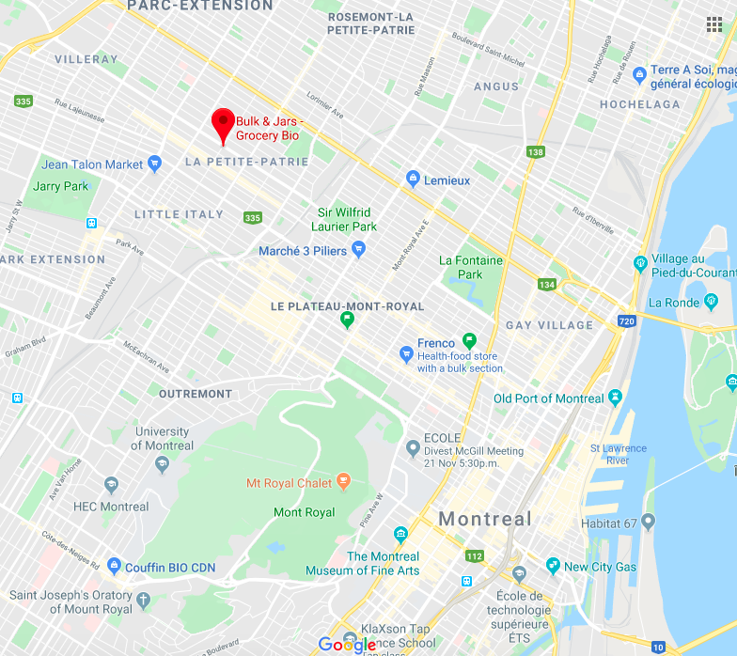
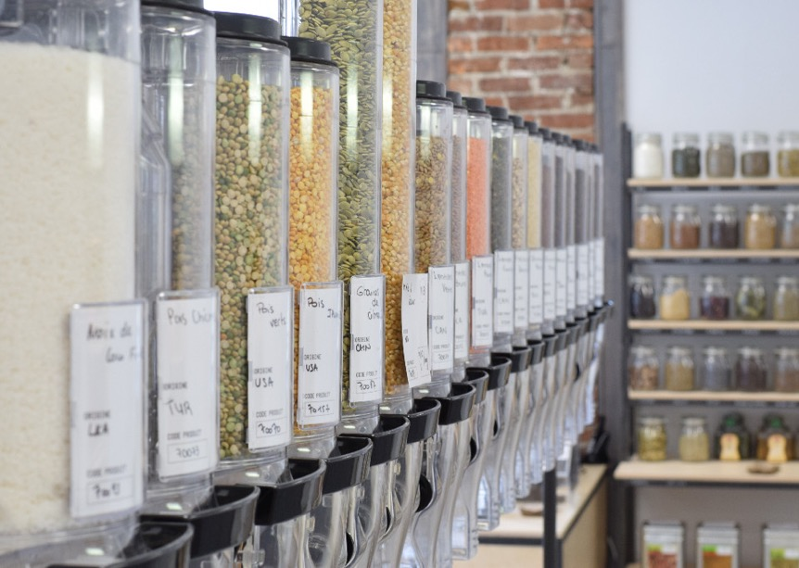
Zero-waste/bulk stores
Vrac & Bocaux

Slide 29
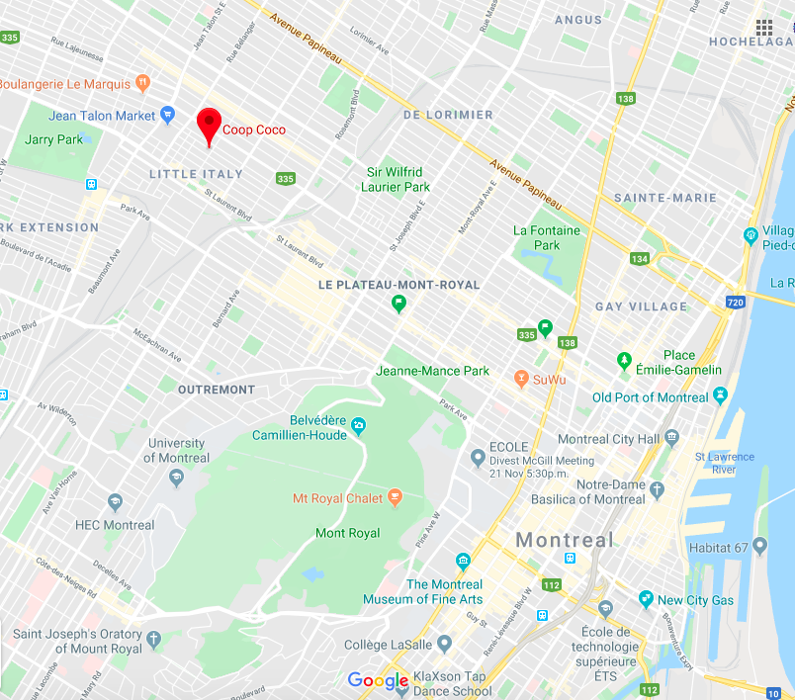
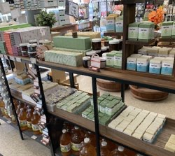
Zero-waste/bulk stores
Coop Coco

Slide 30
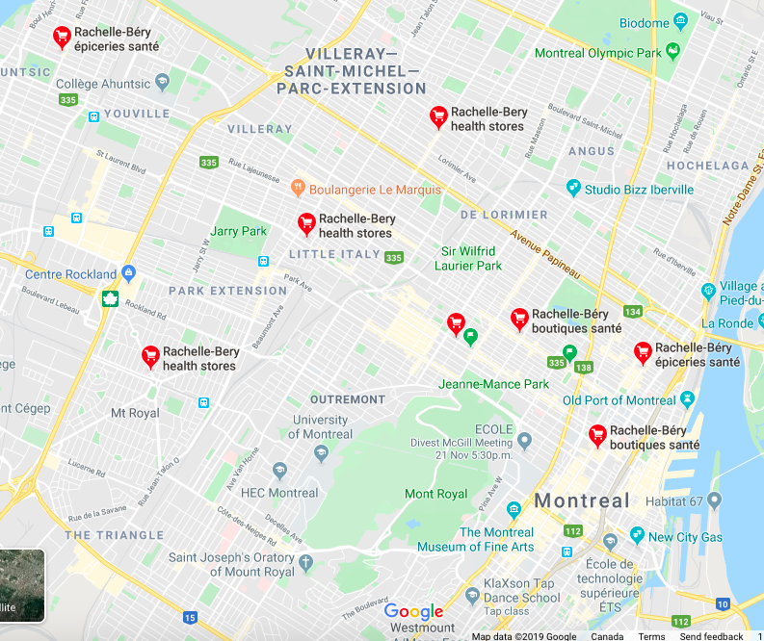
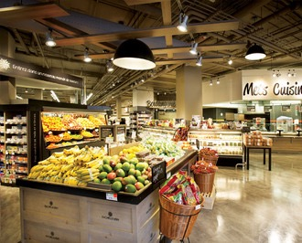
Zero-waste/bulk stores
Rachelle-Béry

Slide 31
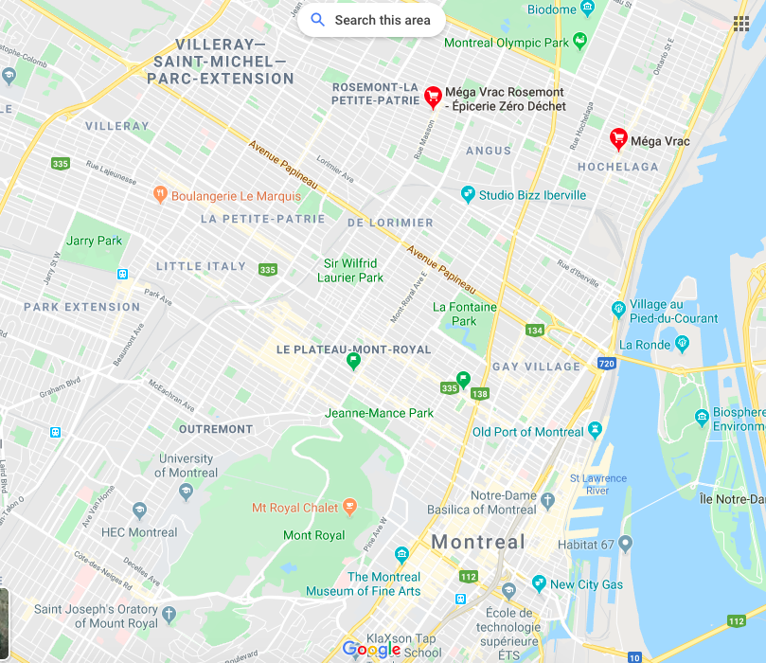
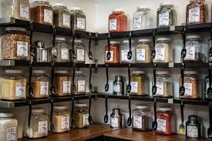
Zero-waste/bulk stores
Méga Vrac

Slide 32
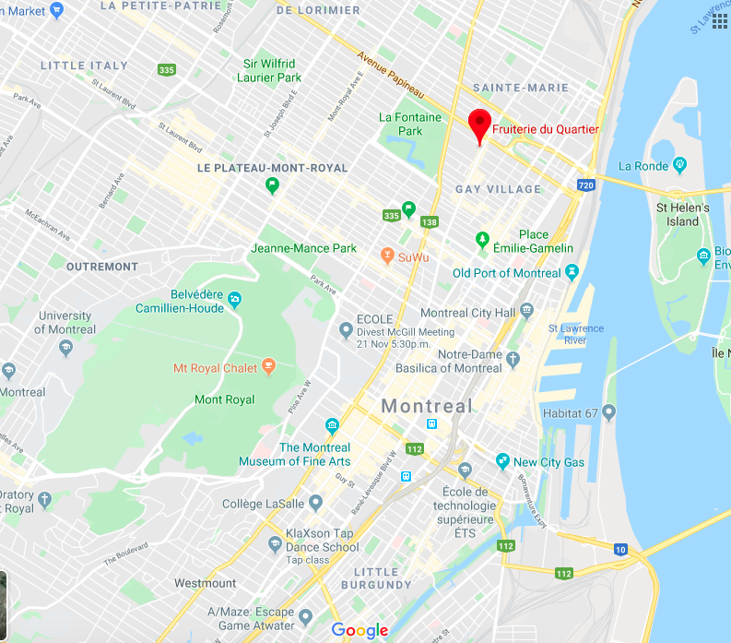
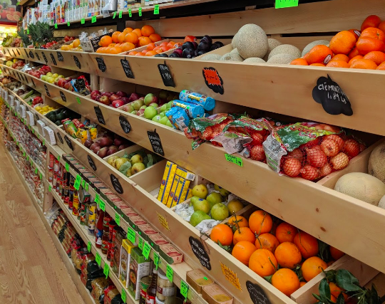
Zero-waste/bulk stores
Fruiterie du Quartier

Slide 33
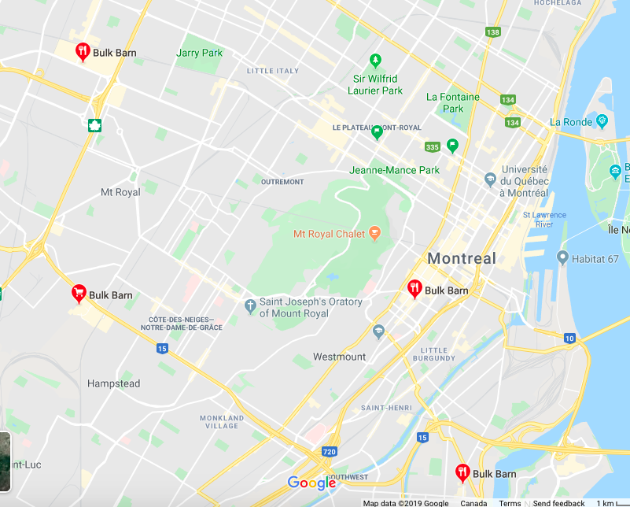
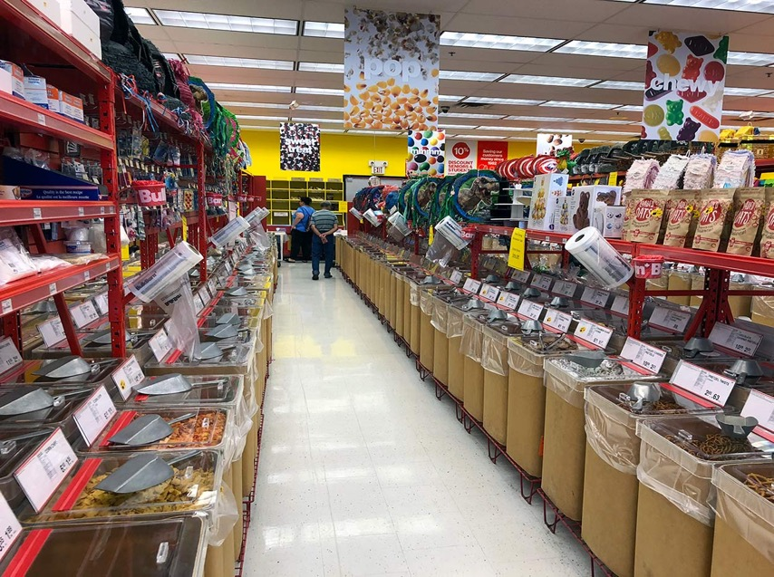
Zero-waste/bulk stores
Bulk Barn

Slide 34
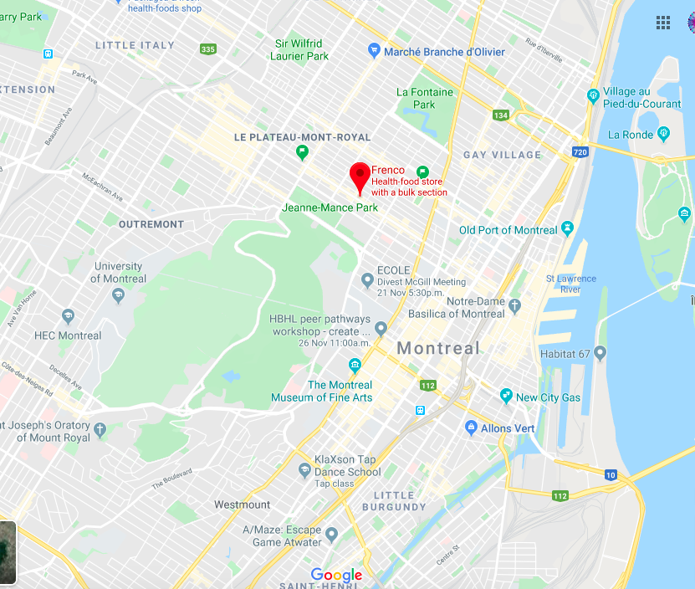
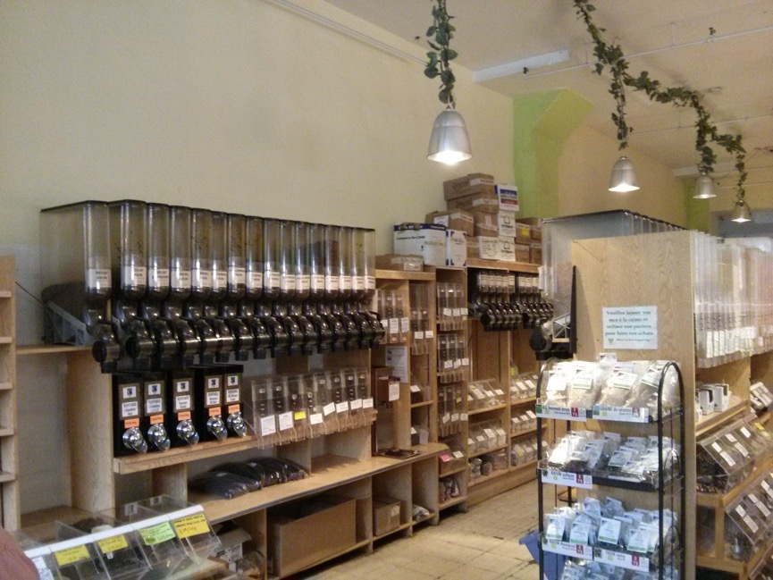
Zero-waste/bulk stores
Frenco

Slide 35
Recycling

Slide 36
Recycling

Slide 37
Accepted | Refused
Paper and cardboard (newspapers, boxes, magazines) | Soiled cardboard (pizza boxes)
Plastic (except No. 6) - bags, containers, bottles | #6 plastic
Metal (canned, aluminum) | Wax paper, paper towels, plastic wrap
Glass (bottle, container) | Tube of toothpaste
 | Saucepan, cake pan
 | Stickers
 | Mirror, glass
 | Garland
 | Cereal or chip bags
https://servicesenligne2.ville.montreal.qc.ca/sel/infocollectes/?lang=en

Slide 38
polyethylene terephthalate soft drink bottles, mineral water, fruit juice container, cooking oil | high-density polyethylene milk jugs, cleaning agents, laundry detergents, bleaching agents, shampoo bottles, washing and shower soaps | polyvinyl chloride trays for sweets, fruit, plastic packing (bubble foil), clear food packaging | low-density polyethylene crushed bottles, shopping bags, carpet | polypropylene furniture, consumers, luggage, toys, bumpers, lining and external borders of cars | polystyrene toys, hard packing, refrigerator trays, cosmetic bags, costume jewelry, CD cases, vending cups, take home containers | other plastics including acrylic, polycarbonate, polyactic fibers, nylon, fiberglass
Notes:
Number 6 is the only plastic that is not able to be recycled.

Slide 39
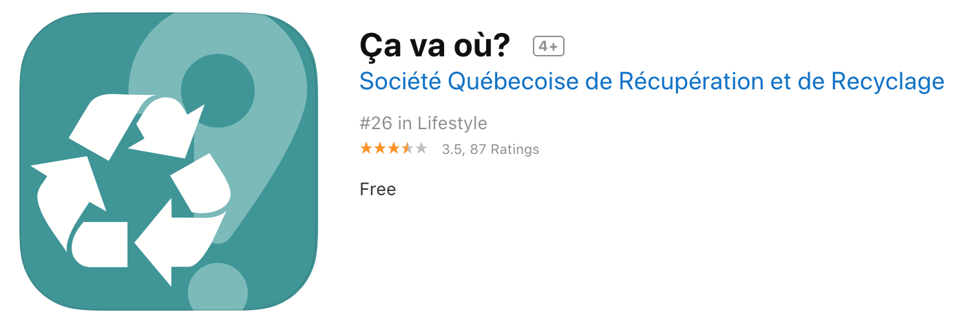
App: ca va ou?

Slide 40
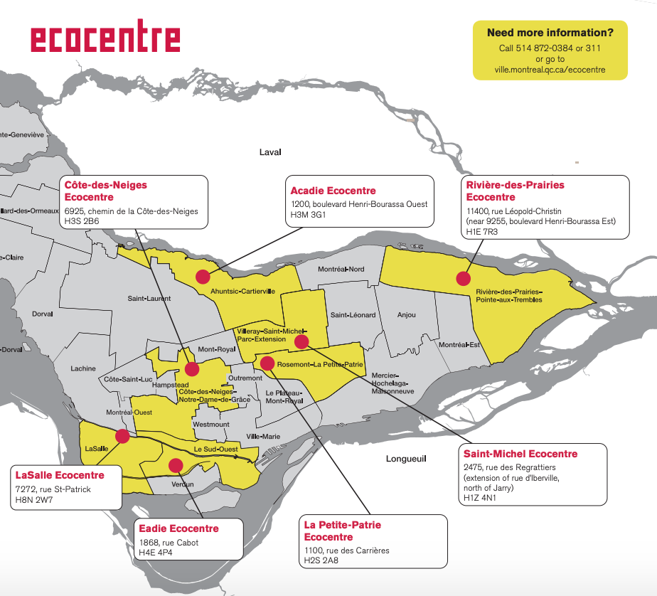
Sorting Centers in Montreal
7 eco-centers in Montreal
http://ville.montreal.qc.ca/portal/page?_pageid=7237,75371938&_dad=portal&_schema=PORTAL

Slide 41
Environmental Complex of Saint-Michel

Slide 42
Why do I have to clean my recycling?
Can spoil other recyclable materials
Remember: soiled cardboard isn’t recyclable!
Cleaning recyclable materials can be energy expensive and time-consuming for sorting centers to conduct on a large scale

Slide 43
Composting
~40% of garbage is food waste

Slide 44
Accepted | Rejected
Raw, cooked or damaged food residues: Fruits and vegetables Nuts and bark Pasta, bread, cereals, RICE Biscuits, sweets, desserts Meat, poultry, bones Eggs and shells Fish and bones, seafood and shells Coffee grounds and filters, tea bags Animal food Spices and herbs | Domestic waste: Liquids (soap, milk, juice, coffee, etc.) Diapers and hygienic products Fabrics, wood, cork, wax, hot ashes Chewing gum Litter and animal excrement Other matters: Paint and hazardous household waste Polystyrene Earth, rock, sand Glass, crystal Non-vegetable oils and fats Batteries
Residues of soiled paper and cardboard: Tissues, paper towels, napkins Paper tablecloths, cardboard crockery Soiled food packaging Pizza boxes | Green residues: Dead leaves, gardening residues *these belong in the green waste collection
Other residues: Hair and animal hair | Recyclable materials: Metal, plastic, paper cardboard
http://ville.montreal.qc.ca/pls/portal/docs/PAGE/ARROND_MHM_FR/MEDIA/DOCUMENTS/AIDE-MEMOIRE_RESIDUS_ALIMENTAIRES_0.PDF

Slide 45
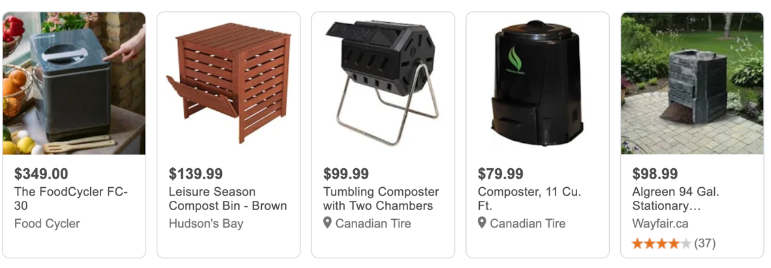
What can I do if I don’t have a compost?

Slide 46
Discount Compost
http://ville.montreal.qc.ca/portal/page?_pageid=7237,75371897&_dad=portal&_schema=PORTAL

Slide 47
Sustainability in the lab

Slide 48
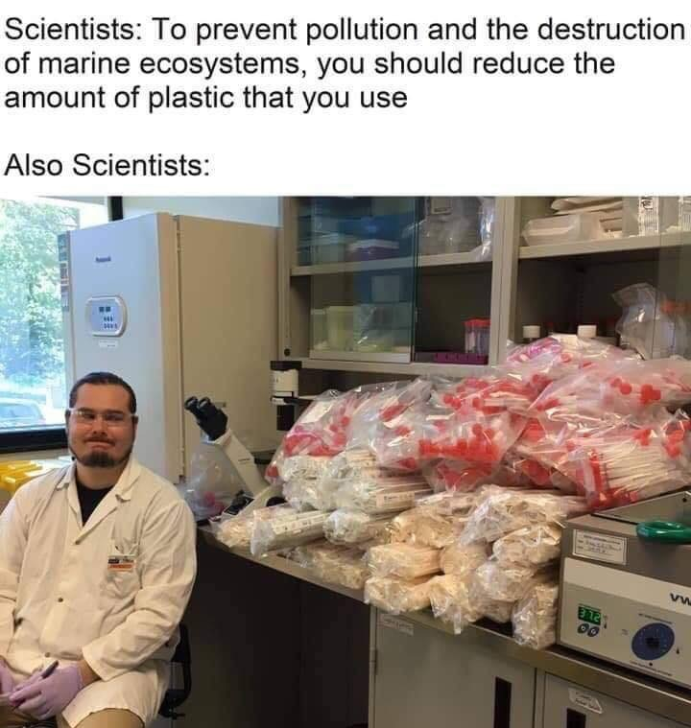

Slide 49
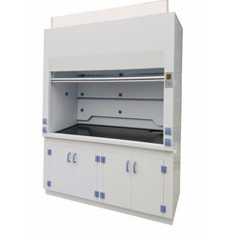
Sustainability in the lab

Slide 50
Sustainability in the lab

Slide 51
Sustainability in the lab
Room 655
https://docs.google.com/spreadsheets/d/1-gMl26kTXA7nNUXAodKd00JGNA8_cShDHhN9TjGZboY/edit#gid=0

Slide 52
Sustainability in the lab

Slide 53
Sustainability in the lab
https://drive.google.com/file/d/1K4JdgDkSPIdseMjcvC9wXjrKoFh5l1YY/view
https://www.amazon.ca/dp/B0061OUSWO/ref=ca_xb_dp_go_web_gl_biss

Slide 54
Kahoot time ☺

